Slide 1



Don’t let POPIA slow down your Database DevOps

Slide 2
Your live webinar link works to watch the recording, in case you get pulled away
Make the console suit you and your screen by resizing and / or moving each window as required
Be sure to check out the useful resources list to discover related content and links
We love to hear from you, so please ask your questions in the Q&A box at any time
About you

Slide 3
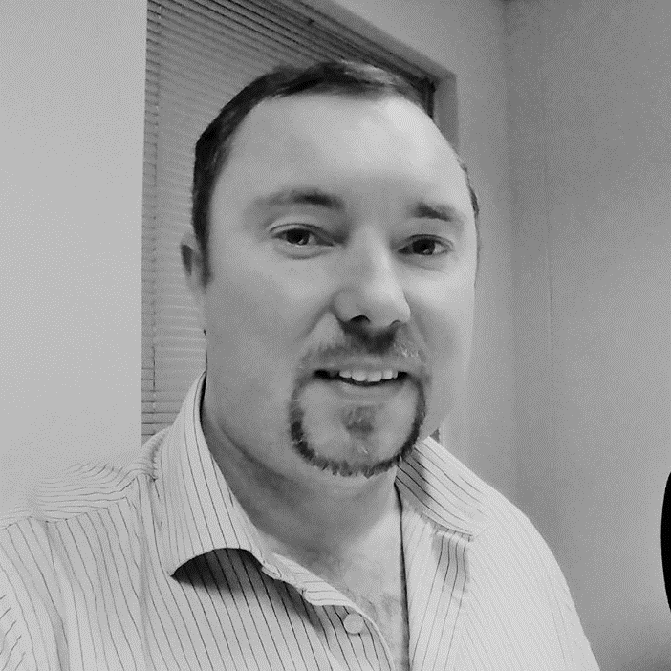
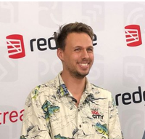
Tyrone Nel
Chris Unwin
Solutions Architect
Solutions Architect
Blue Turtle
Redgate Software
tyronen@blueturtle.co.za
Chris.Unwin@red-gate.com
/in/tyrone-nel-38083a24/
@PlantBasedSQL

Slide 4

A little about Redgate…
300
20
202,000
Redgaters and counting
years old
customers
2m
91%
1147
SQL Server Central and Simple Talk users
Of the Fortune 100 use our tools
product releases last year

Slide 5
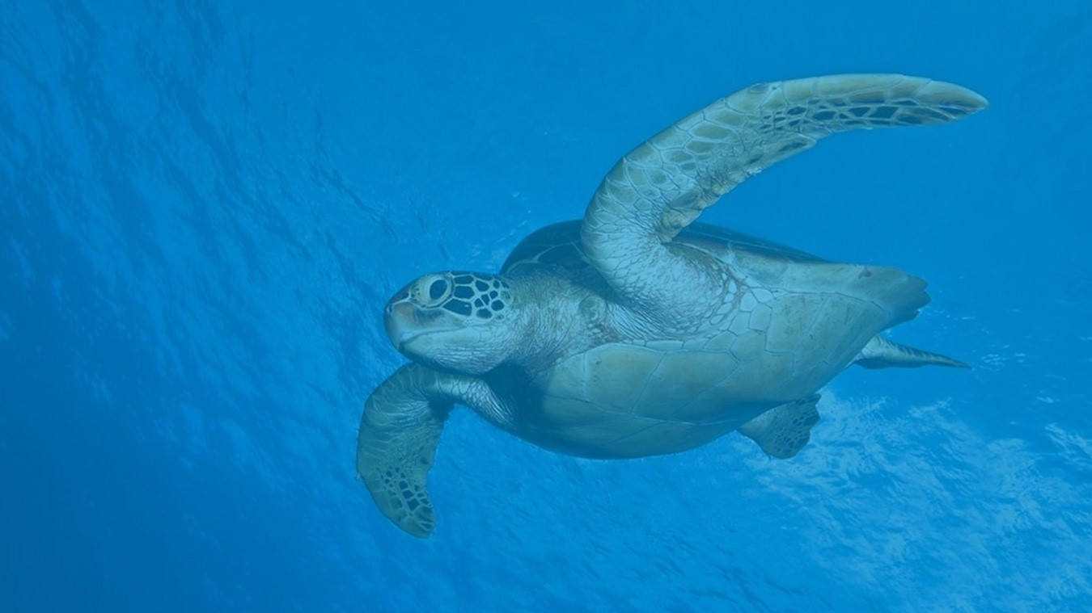
A little about Blue Turtle…
2003
Year Founded
140+
Blue Turtle Team
300+
Enterprise Customers Throughout Africa
BBBEE
Level 1
Redgate Partner
Sole partner for Southern Africa

Slide 6
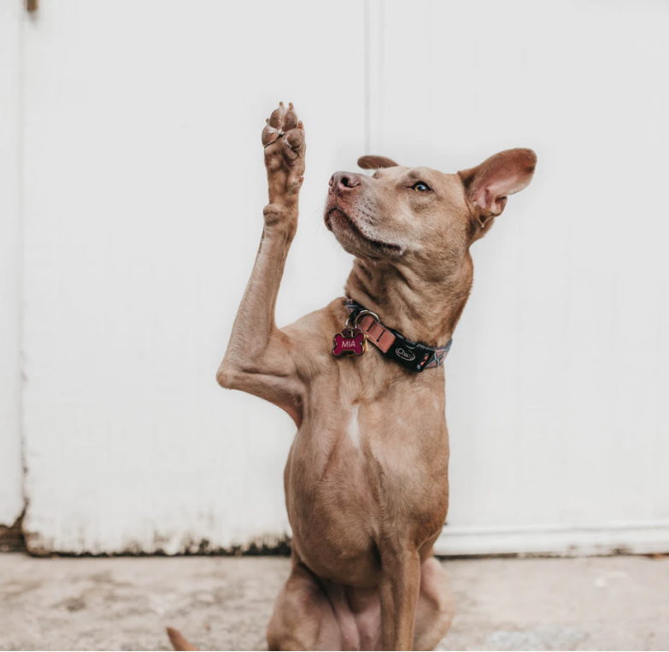
We want to hear from you!
Notes:
Photo: https://unsplash.com/photos/AoqgGAqrLpU

Slide 7
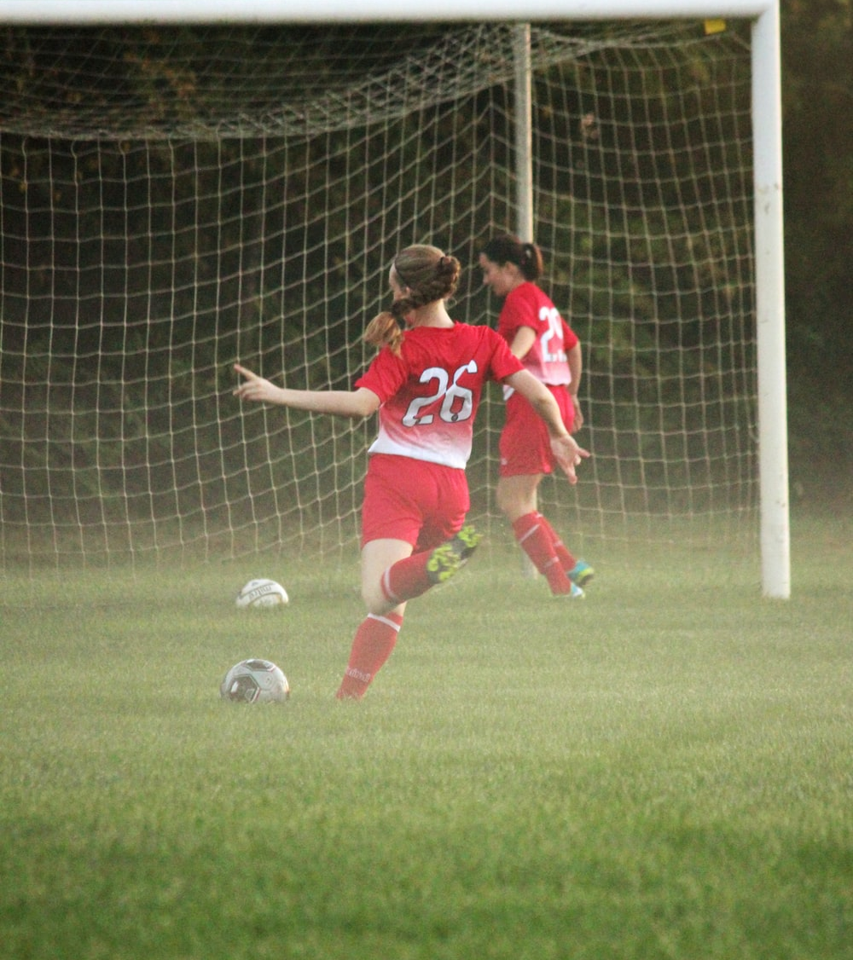
Goal
You will be able to describe:
1. How Database DevOps with Redgate and BlueTurtle enhances Developer Agility.
2. Shortens Dev Cycles and reduces Time to market all whilst being POPIA compliant!
Notes:
Photo: https://unsplash.com/photos/yPpMuUXm78A

Slide 8
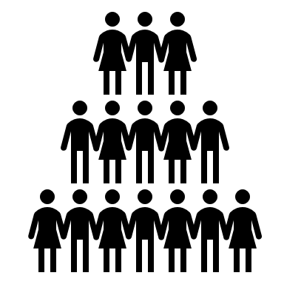
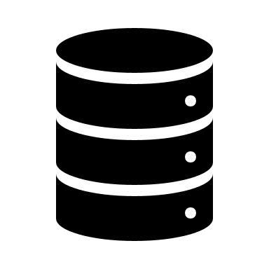




What is POPIA…
Protection of Personal Information Act
Applies to All Personal Information (PI) in Any Format
Prescribed set of Protection Rules for Storing and Processing PI
Substantial Fines and Jail Time!

Slide 9





…and why do we care?
Do you have lots of Non-Production Data for Dev, Test and BI?
Non-Production Data is at the DevOps beating heart of a company
Reasonable and Appropriate Security Measure are required
PI data may only be used for its Original Intent

Slide 10



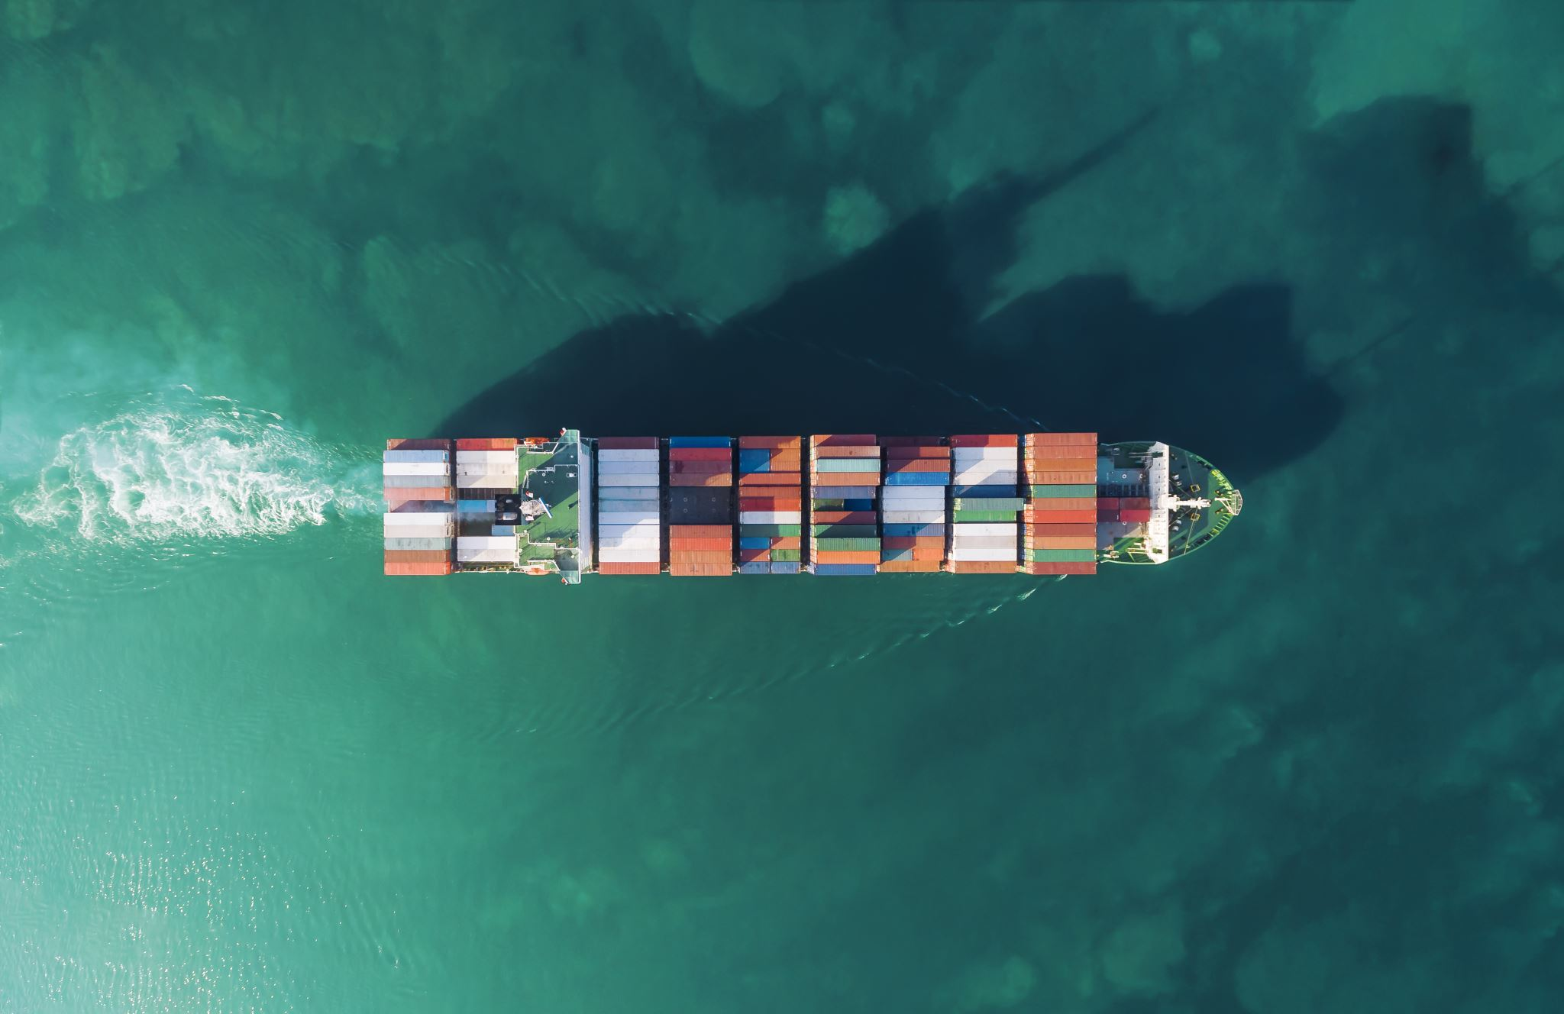



Key challenges
Business Applications were not designed to handle POPIA
Production has tight controls...Non-Production less control...more Proliferation of Data
This is a hot potato someone must own and hold onto
You don't know what you don't know. Scary!

Slide 11





Recommended approach when getting started
What do you define as sensitive data?
How much data do you hold?
Who are the data stewards?
What is it being used for and where?
Do you have existing Policies?
Combinations of data that are more sensitive or valuable?

Slide 12
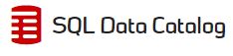
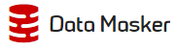
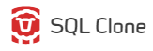
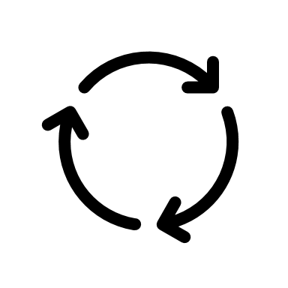


Fear not! We have a solution
Find your PI Data
Mask your PI Data
Provision your Masked Data
Congratulations!
Reasonable and Appropriate Security Measures are now place for Non-Production Data!

Slide 13
“Where data is involved, multiple rules will apply - it is simply not enough to draw one line in the sand; plans must be designed, processes re-evaluated, and a defensible position built from all sides.”
- Tyrone

Slide 14
GDPR is going nowhere…
An EU act that protects personal information
Applies to All Personal Information (PI) in Any Format
PI data may only be used for its Original Intent
Reasonable and Appropriate Security Measure are required

Slide 15
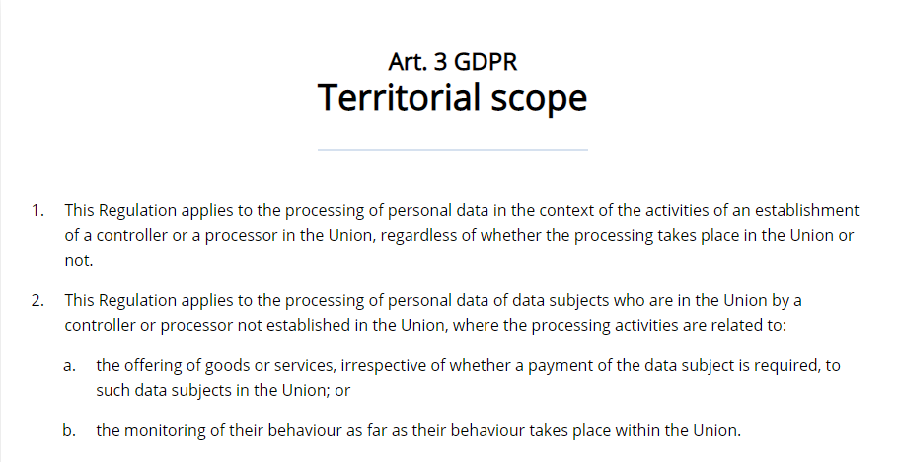
…and it still applies in South Africa

Slide 16



GDPR Requirements
Purpose limitation: Only use for what was consented
POPIA Principle 2
Integrity and Confidentiality: Protection from unauthorised access or use
POPIA Principle 7
Accountability: Prove it.
POPIA Principle 1

Slide 17
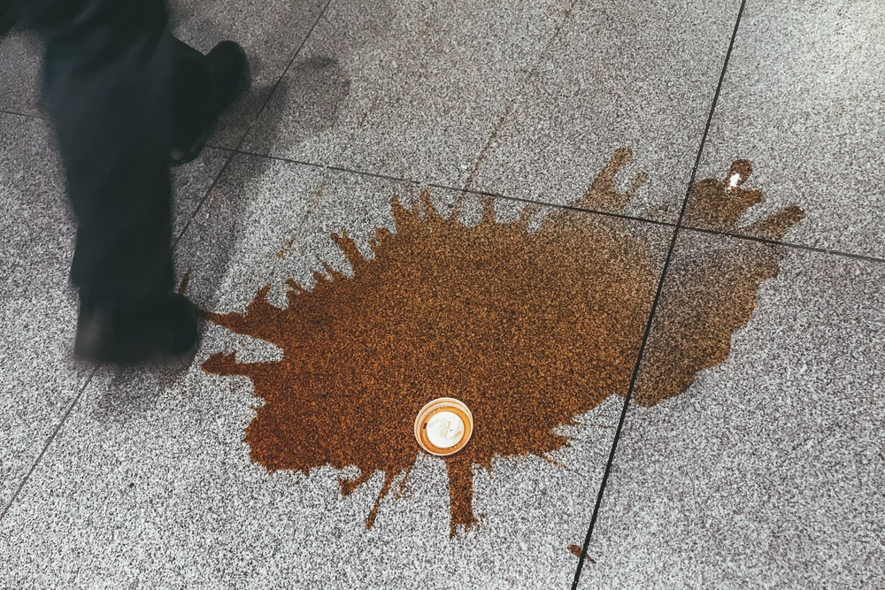

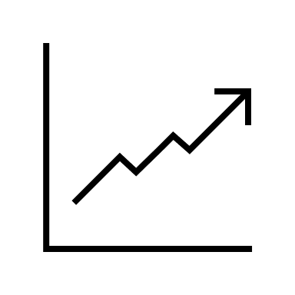
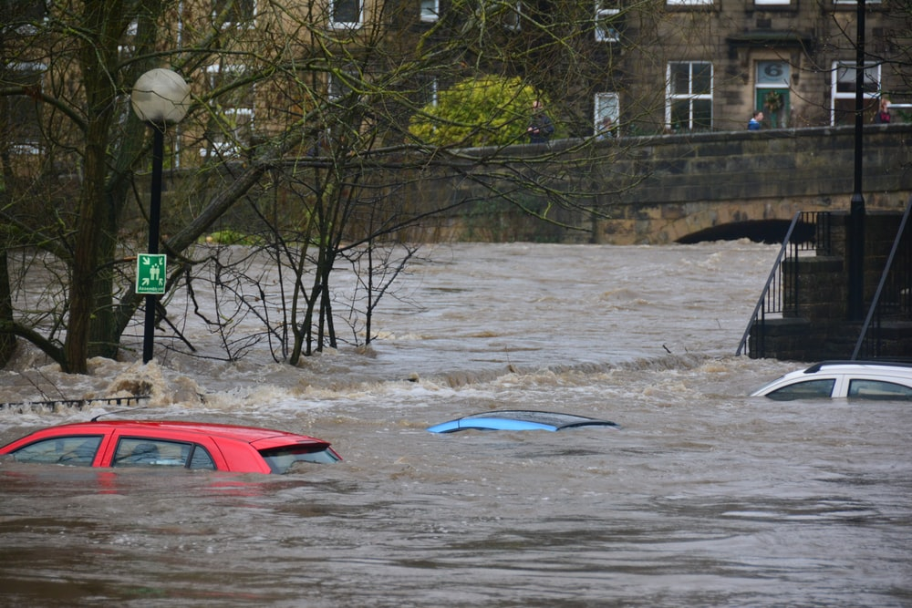
GDPR Fines
Lower Severity:
10 million
2% of global turnover
Whichever
is greater.
Higher Severity:
20 million
4% of global turnover
A maximum fine for McDonalds*, for example would be €860 million or R17,728,109,169…
Notes:
Photo Sources:
https://images.unsplash.com/photo-1578651714116-2a1645b70c0f?ixlib=rb-1.2.1&ixid=eyJhcHBfaWQiOjEyMDd9&auto=format&fit=crop&w=1267&q=80
https://images.unsplash.com/photo-1547683905-f686c993aae5?ixlib=rb-1.2.1&ixid=eyJhcHBfaWQiOjEyMDd9&auto=format&fit=crop&w=1350&q=80
McDonalds declared revenue: https://www.statista.com/statistics/208917/revenue-of-the-mcdonalds-corporation-since-2005/

Slide 18
How have our customers responded to GDPR?
Find your PI Data
Mask your PI Data
Provision your Masked Data
Know what you have and where it is stored
Build out protective mechanisms to sanitize the data
Don’t let compliance slow down DevOps, build it in from the ground up

Slide 19
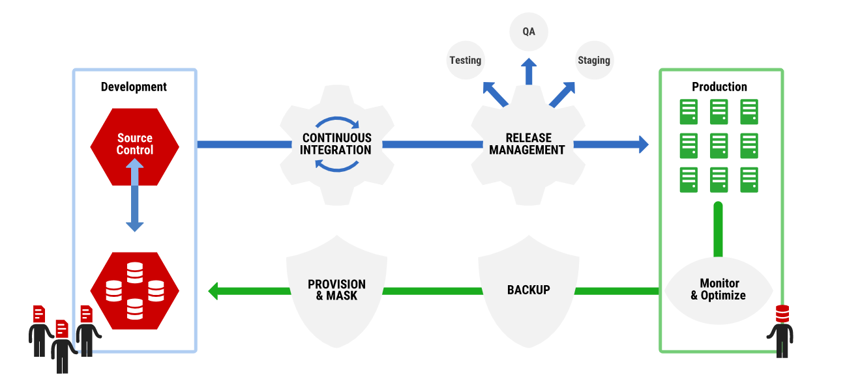
The answer is Compliant Database DevOps
Notes:
Image: https://www.red-gate.com/solutions/overview

Slide 20
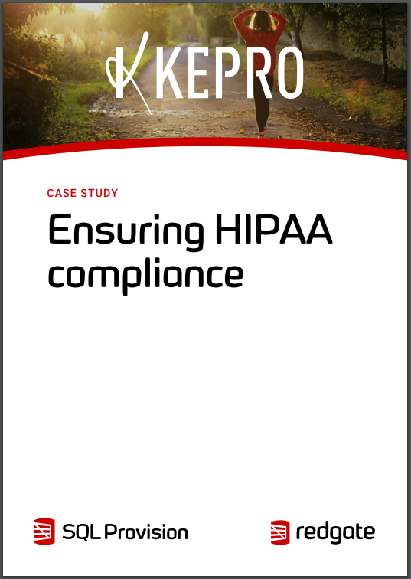
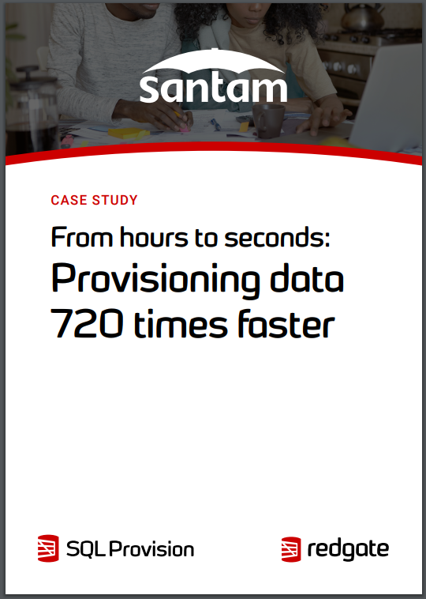
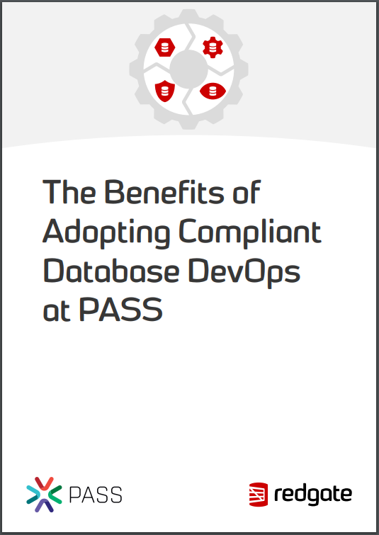
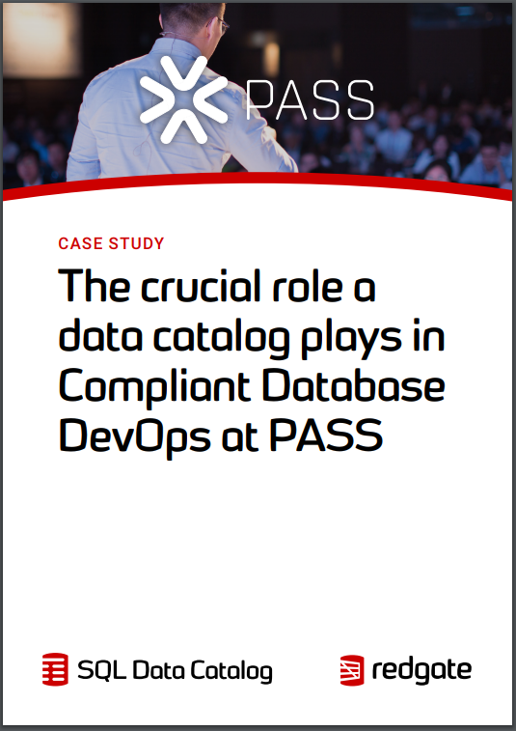
Find out from people who already did it!
Notes:
Case Study Links:
https://assets.red-gate.com/products/dba/sql-provision/kepro-case-study.pdf
https://www.red-gate.com/products/dba/sql-provision/case-studies/santam-provisioning-data-faster
https://assets.red-gate.com/solutions/pass-redgate-compliant-database-devops.pdf
https://www.red-gate.com/products/dba/sql-data-catalog/case-studies/data-catalog-database-devops-pass

Slide 21
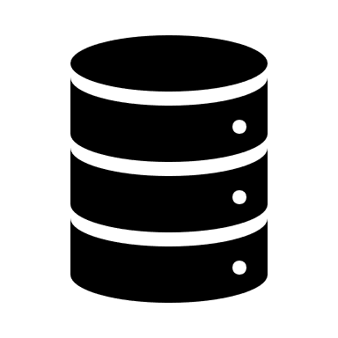




Setting the scene
We’re DBAs at TurtleGate Inc.
Project POPIA_SEEDS needs data, now.
We’re not sure exactly what information we hold
The main DB is 1.25TB
The database is filled with PI

Slide 22

Secure Database Provisioning in action!
Notes:
Image Source: https://unsplash.com/photos/FwF_fKj5tBo

Slide 23


Conclusion
POPIA is applicable to everyone who collects, hold and processes personal information
Pre-production is an attack surface area we do not need to have
Redgate and Blue Turtle can help your teams achieve a POPIA defensible position

Slide 24

Questions / Comments

Slide 25

Thank you for watching!

